Slide 1
Teaching Bursary Scheme
Universities Toolkit

Slide 2
What’s in this toolkit?
Background information
Blog assets
Social media posts Contact information

Slide 3
What’s the toolkit for?
This resource has been created for use by training providers and other partners to help promote the scheme
It acts as a guide on how best to amplify the scheme across your
key web and social media channels
Any case studies/film from your own organisation can be used
as well as the information provided in this toolkit
You can create your own posts and talk more about your own organisation’s part in the Teaching Bursary Scheme.

Slide 4
Eligibility
To be eligible to apply for the 2023/24 scheme, candidates must:
have been in employment for at least 36 out of the last 84 months,
including career breaks and furlough
hold a 2.1 degree or meet the minimum ITE entry requirement with a relevant masters in their subject area
including exceptions, applicants ordinarily need to have been out of full time education since 30th September 2020
For the Gaelic education courses, you must be a fluent speaker and be able to read and write in Gaelic

Slide 5
Suggested blog copy
Are you looking to career change to inspire the next generation?
The Teaching Bursary Scheme is to encourage more people to retrain as secondary school teachers in selected STEM subjects and Gaelic at both primary and secondary education. Gaelic being a new addition of academic year 23/24. The scheme was opened by Skills Development Scotland in June 2023.
These are the subjects with greatest demand for teachers. The £20,000 bursary is available for career changers in the next academic year whilst studying for a PGDE in the relevant subjects.
Tanya Howden, from Edinburgh, has taken advantage of the bursary going on to train as a Computer Science teacher. She said: “Through working with schools and seeing the impact we were having it made me realise that now was the right time to take a step into teaching.
“But without the bursary it would’ve been a much different story. It’s much harder to imagine stopping a full-time salary once you’ve become used to having one, and then go back to being a student again.
“There’s a lot of academic work that needs be completed within the one year, so there’s no way I could’ve worked part- time. So it’s a case of all hands on deck on the teaching side. The bursary has taken a massive worry off my shoulders.”
For further information please visit https://teachingbursaryinscotland.co.uk/

Slide 6
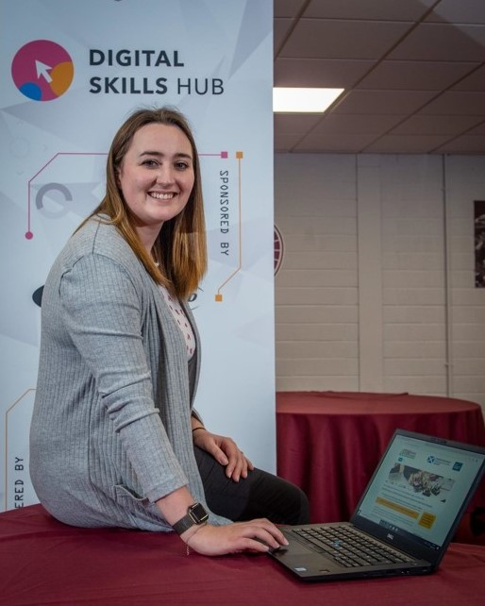
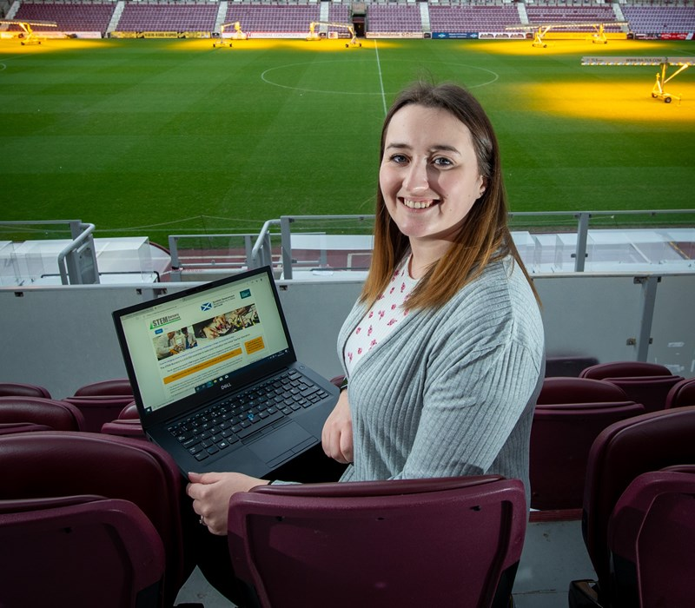
Blog Photos
Tanya Howden

Slide 7
Social media posts
Are you looking to #careerchange to inspire the next generation? Applications are now open for £20,000 of support to retrain as a school teacher in #STEM subjects and #Gaelic https://teachingbursaryinscotland.co.uk/ #teach #bursary #Scotland
Bursaries of £20,000 are being offered to encourage people to retrain as school teachers in #STEM and #Gaelic subjects https://teachingbursaryinscotland.co.uk/ #teach #bursary #Scotland
Apply for a £20,000 bursary to retrain and fill the high-demand for teaching roles in Physics, Chemistry, Maths, Technological Education, Home Economics, Computing Science and #Gaelic https://teachingbursaryinscotland.co.uk/ #teach #bursary #STEM #Scotland
Looking for a fresh start in a new career? Scotland’s Teaching Bursary Scheme Scheme exists to help you train as secondary school teacher in #STEM and #Gaelic subjects https://teachingbursaryinscotland.co.uk/ #teach #bursary #Scotland

Slide 8
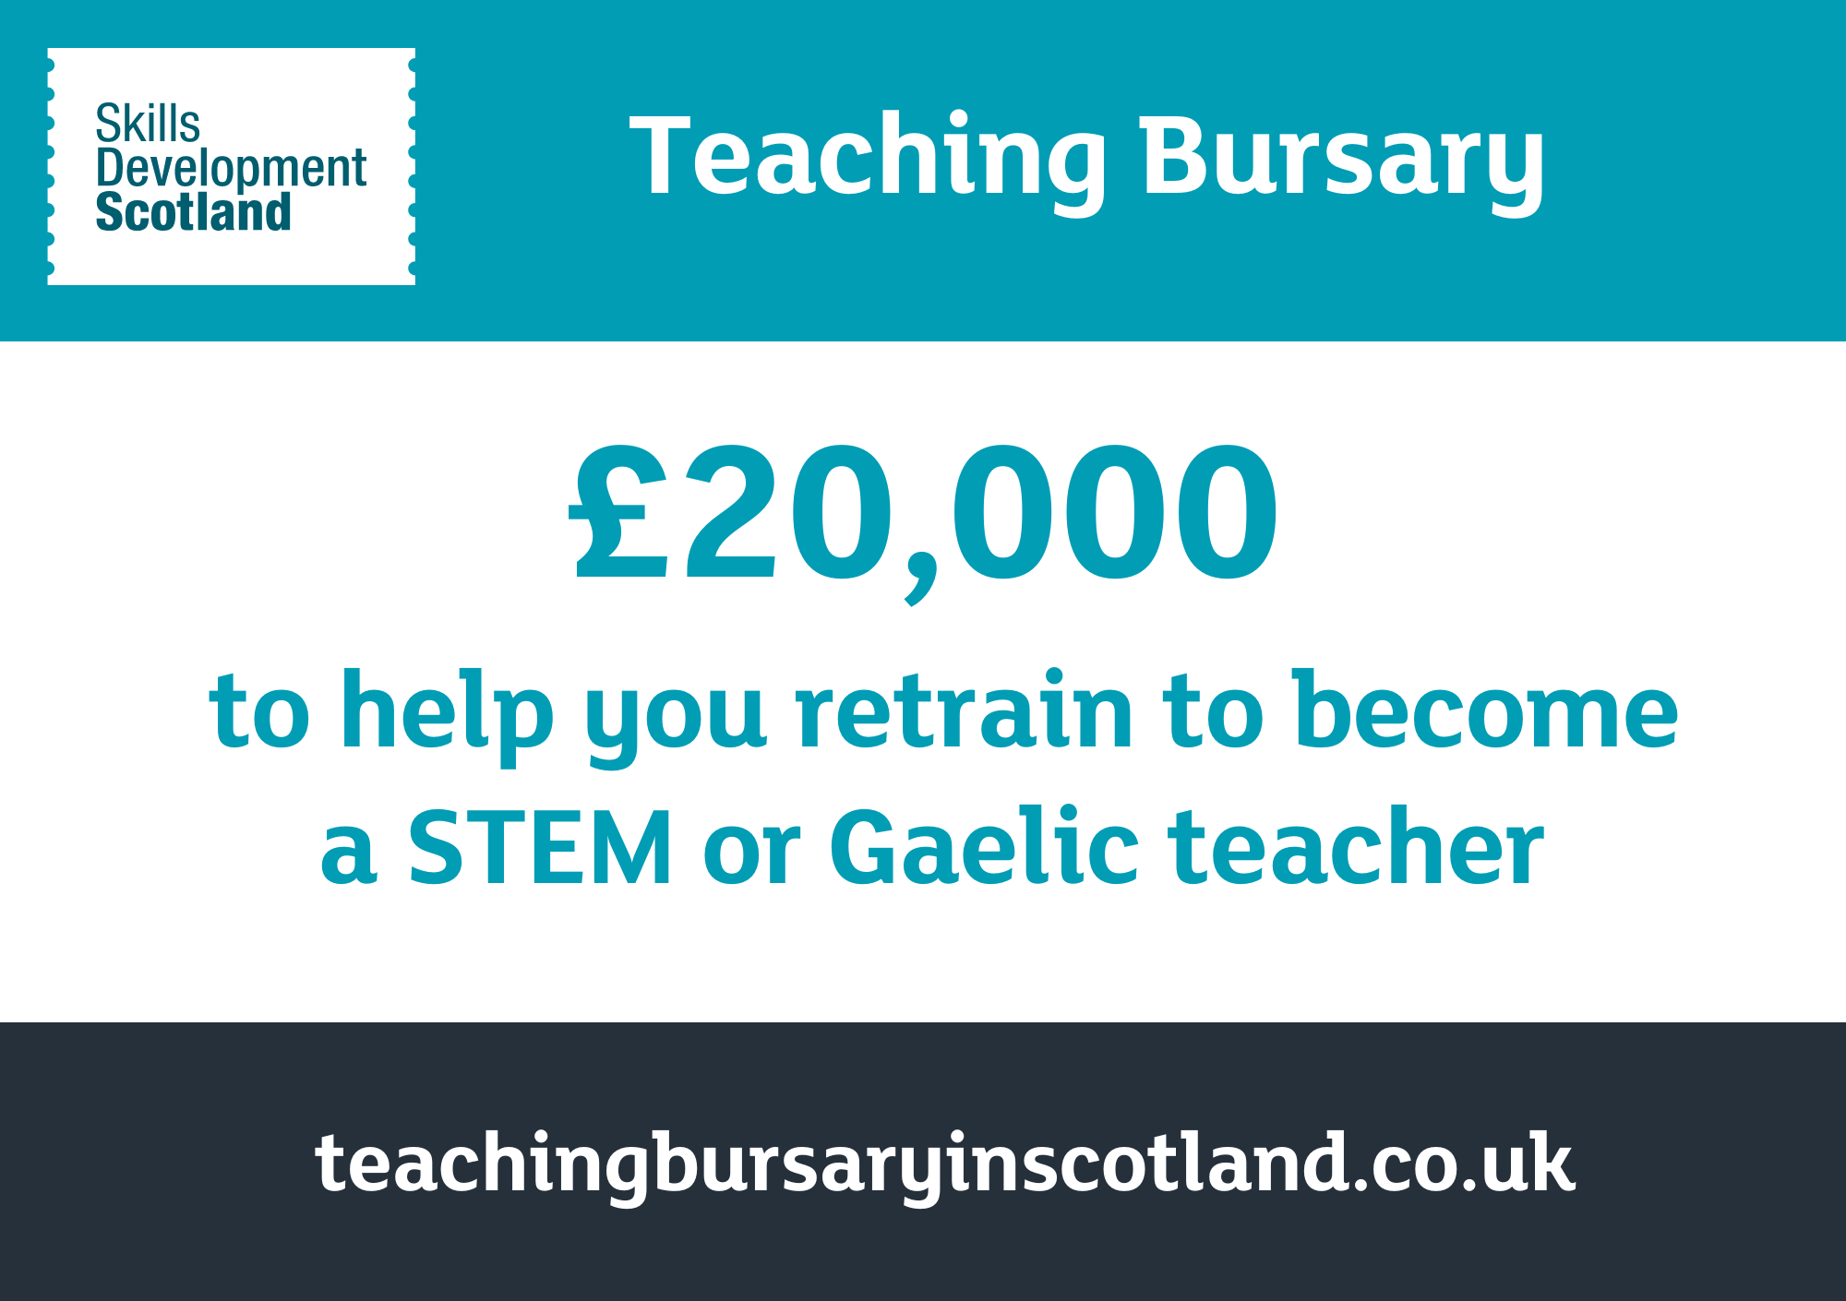
Social media assets

Slide 9
Social media assets

Slide 10
For further support in promoting the Teaching Bursaries:
Niall Rolland
Communications and Marketing
Skills Development Scotland
niall.rolland@sds.co.uk

