Slide 1
External Examiners Preview Demonstrations Academic Services & Student Systems
Presented by Daniel Chandler, Project Officer, Academic Services &
Matthew Taylor, Training & Communications Manager, Student Systems

Slide 2
External Examiners Project
Aim & objectives
Why is it important?
Who is involved
Time frame
Business process
Policy development

Slide 3
Aims & Objectives
Aims:
The delivery of an online external examiner reporting system.
Objectives:
The generation of online responses to external examiners
The delivery of IT tools to facilitate the extraction of common themes from the reports at School level, College level and at the Institution level
The review and revision of business processes and policy throughout the external examiner processes.

Slide 4
Why is it important?
The streamlining of processes will make external examiner reporting and the University responses to reports more effective and efficient
The IT tools will assist with the extraction of common themes from external examiner reports and will enable the University to disseminate good practice identified in reports
The analysis of common themes will demonstrate that the University is making scrupulous use of external examiner reports in its institutional QA processes and strategies.

Slide 5
Who is involved?
Four Strands:
External Examiner
Administrator
Report Assessor
Policies

Slide 6
Time Frame
October – December 2013: Project established; user groups set up; Policy Working Group set up
December 2013 – February 2014: Process analysis; user stories gathered; policy developed; pilot schools identified
July 2014: System build completed; final draft of policy circulated
August – November 2014: Pilot runs (PGT Exam Boards)
August 2014 - March 2015: Evaluation and enhancement of system
April 2015: Full roll-out of system

Slide 7
Business Process
One nominated responder for each report
No cascading
Multiple readers of reports
Quick analysis of report data at School, College and University level for QA processes

Slide 8
Regulations and Policies
Current:
University’s Taught Assessment Regulations and Guidelines
Code of Practice for External Examiners of Undergraduate and Taught Postgraduate Programmes
New:
Handbook for External Examiners of Taught Programmes
External Examiners of Taught Programmes Policy

Slide 9
External Requirements
QAA Quality Code, Chapter B7: External Examining
Indicator 2
Awarding institutions expect their external examiners to provide informative comment and recommendations upon whether or not:
an institution is maintaining the threshold academic standards set for its awards in accordance with the frameworks for higher education qualifications and applicable subject benchmark statements.
the assessment process measures student achievement rigorously and fairly against the intended outcomes of the programme(s) and is conducted in line with the institution's policies and regulations the academic standards and the achievements of students are comparable with those in other UK higher education institutions of which the external examiners have experience.

Slide 10
Programme External Examiner
There must be at least one Programme External Examiner appointed who has responsibility for oversight of provision that leads to a higher education award.
Guidance: It is likely that the Programme External Examiner will also be examining a course or courses on the programme and oversight of the programme will be an additional role.
Programme External Examiners are appointed to give oversight of a whole programme or cognate student pathways leading to the degree award.

Slide 11
Programme External Examiner
The Programme External Examiner is not a ‘Chief Examiner’.
It is expected that the Programme External Examiner will take note of the views of his or her fellow Course External Examiners on the Board in forming his or her judgement about the programme and degree award.

Slide 12
Software Demonstration

Slide 13
Aim
The aim of this demonstration is to provide a preview of the new EERS software for processing and analysing External Examiner reports:
Allocating Academic Response Co-ordinators to respond to External Examiners reports
Submitting a report as an External Examiner
Viewing reports
Responding to reports
Monitoring report submissions deadlines
Recording payment
Thematic Analysis

Slide 14
Introduction
PGT only
Piloted to 10 schools
All 3 colleges will have at least 1 school represented in the pilot
In use September - November 2014 (PGT exam board)

Slide 15
Training
End July implementation
August data capture (Not in use until September)
Additional preview sessions can be arranged by request for those unable to attend
Online tutorials to be complete by beginning of September (for Key School/Key College contact role)
EERS classroom training for Response Co-ordinators to take place between late Sept & late Oct (After Exam boards)
BIS reporting classroom training for Thematic Assessors between mid Oct to mid-November

Slide 16
Roles
External Examiner
Academic Response co-ordinator
Key School contact
Key College contact
Payment Administrator
Thematic Assessor (Business Intelligence reporting)
Readers/Contributors

Slide 17
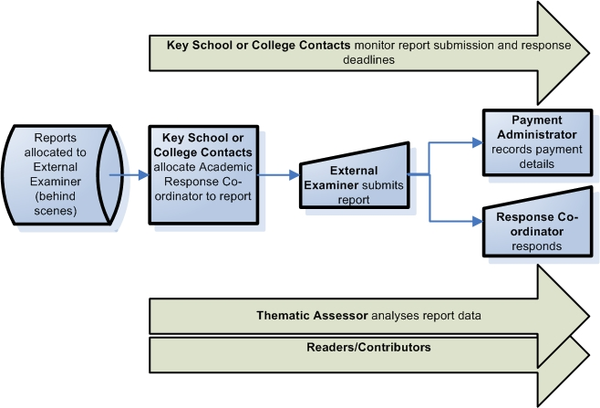
Core process map

Slide 18
Key School Contact
View reports (administration details and responses)
Monitor reports
Unallocated reports
Reports of interest
Add internal notes against reports
Reporting Search facility
Amend report deadlines
Allocation of Response Co-ordinator to respond to External Examiner reports

Slide 19
External Examiner
Report draft/submission
Reason
Suggestions
Commendation
Active reports
View Response Co-ordinator’s report response
General guidance

Slide 20
Academic Response Co-ordinator
Reports Requiring Responses
View reports
Summative view
Original view
Responding to reports
Sending an email to the External Examiner

Slide 21
Payment Administrator
View reports
Record and confirm institute payment dates

Slide 22
Key College Contact
View reports
Monitor reports
Unallocated reports
Reports of interest
Add internal notes against reports
Reporting Search facility
View and chase late Reports

Slide 23
Business Intelligence (BIS) Reporting
View submitted reports and responses data within Business Objects reports
Analyse report data within Business Objects InfoSpace
Run External Examiner response web intelligence reports

Slide 24
Readers/Contributors
Readers
May view the submitted report at any time
Contributors
Notified once a report has been submitted
Academic Response Co-ordinator might take feedback on report recommendations from another party, set up on the allocation lists
Data Protection breach
Reports shouldn’t refer to protected personal data. The DPA can flag issues of this kind recorded in the External Examiner report.

Slide 25
Questions?

